Slide 1

Risk-Reward in the Bond Market
Risk and Reliability Analysis
10/1/2021

Slide 2
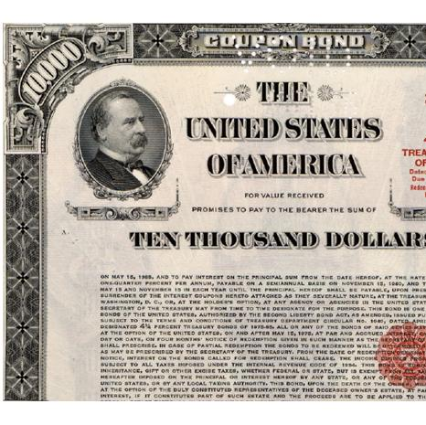
What is a bond?
A bond is an assumed debt taken on by an entity.
In most cases, a bond is issued by a corporation or a government entity as a way to borrow from individuals.

Slide 3
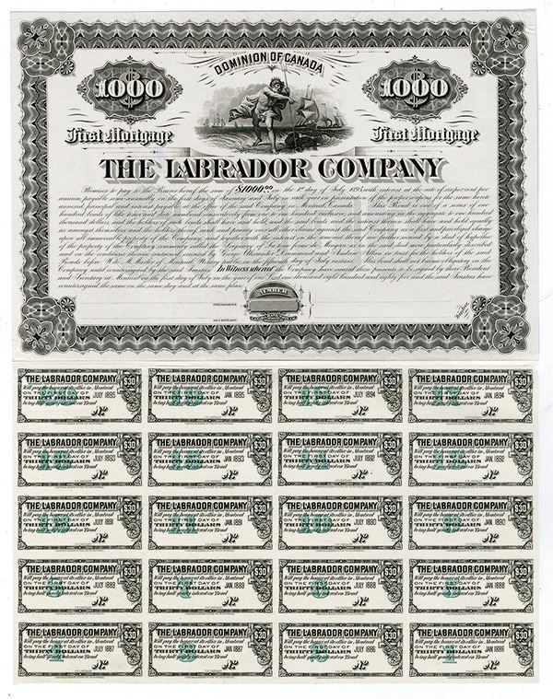
What is a bond?
Face Value
A bond is build of three major components.
Face Value: This is the amount of money initially paid for the bond. Fixed at time of agreement
Coupon Value: This is the amount of ‘return’ on your investment. This is paid out at set intervals. Fixed at time of agreement
Duration: How long the bond is active. Fixed at time of agreement
Coupon Value

Slide 4
How do it work?
Let’s say you agree to a $1000 bond that pays out $100 coupons every year for 5 years.
The total value of the bond can be $1500 dollars!
That’s a great deal, isn’t it!?
-1000
100
100
100
100
1100

Slide 5
Things to consider.
Turning 1000 dollars into 1500 dollars is a very attractive option, but there is something else to consider.
When doing any sort of investing it’s important to consider all the options available to you.
What are other methods of getting ‘free’ money via investing?

Slide 6
Discount Rate, or … interest rate?
Regardless of inflation, it is important to take the discount rate into account when dealing with future money.
The discount rate is the interest rate set by the Federal Reserve Bank.
The discount rate should represent the base amount of interest available if you invest elsewhere.

Slide 7
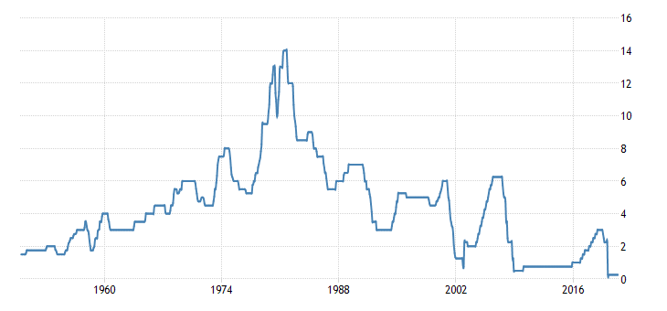
US Federal Reserve discount rate

Slide 8
Considering discount rate
The amount of money we earn should take the discount rate into consideration.
To do that, let’s break the value of our bond into two components from earlier.
The Face value
And the Coupon value

Slide 9

Face value
The face value of our bond is the amount of money initially put in.
To determine the value of this at time of maturation we can use the following equation.
$$F_{future}=\frac{F_{present}}{{\left(1+r\right)}^{time}}$$
Where r is the discount rate, and time is the total time of maturation.

Slide 10
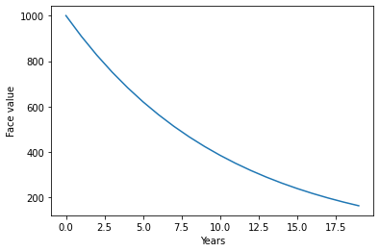
Face value
What happens to the face value of a bond with a 10% discount rate?

Slide 11
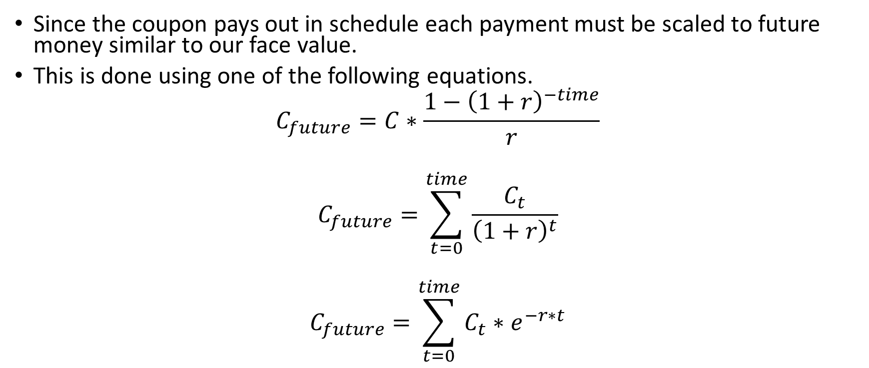
Coupon Value
Since the coupon pays out in schedule each payment must be scaled to future money similar to our face value.
This is done using one of the following equations.
$$C_{future}=C∗\frac{1−{\left(1+r\right)}^{−time}}{r}$$
$$C_{future}=\sum_{t=0}^{time}{\frac{C_{t}}{{\left(1+r\right)}^{t}}}$$
$$C_{future}=\sum_{t=0}^{time}{C_{t}∗e^{−r∗t}}$$

Slide 12
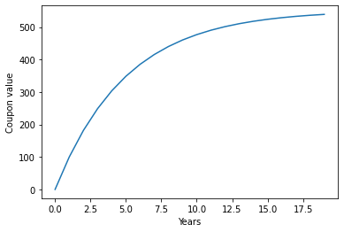
Coupon Value
What happens to the coupon value at a 10% discount rate?

Slide 13
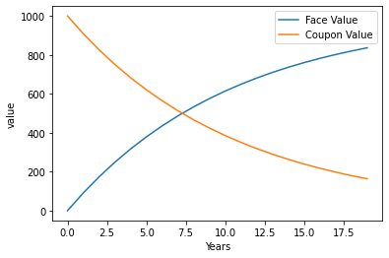
Together!

Slide 14

Together … again!
$$C_{future}=C∗\frac{1−{\left(1+r\right)}^{−time}}{r}$$
$$F_{future}=\frac{F_{present}}{{\left(1+r\right)}^{time}}$$
$$NPV= C∗\frac{1−{\left(1+r\right)}^{−time}}{r}+\frac{F_{present}}{{\left(1+r\right)}^{time}}$$

Slide 15
Comparing Bonds
You agree to a 1000 face value, 100 coupon bond for the next 5 years. The market rate is currently 10%.
The second after you agree to this bond the market rate shifts to 8%. Is that good or bad for you?

Slide 16

Risk in Bonds
Where does our risk come from?
Hint: What is variable in our equation?
$NPV= C∗\frac{1−{\left(1+r\right)}^{−time}}{r}+\frac{F_{present}}{{\left(1+r\right)}^{time}}$

Slide 17
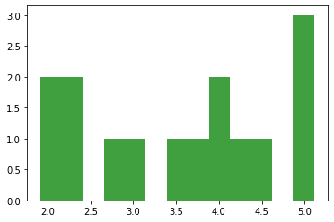
Historic Interest Rates Histogram

Slide 18
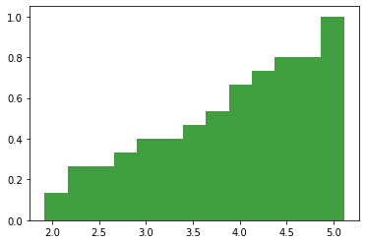
Historic Interest Rates – Cumulative Histogram

Slide 19
Using CDF in Monte Carlo
How can we use a CDF to extract an interest rate?

Slide 20
Using CDF in Monte Carlo
How can we use a CDF to extract an interest rate?
Randomly sample a uniform distribution!

Slide 21
Using CDF in Monte Carlo
How can we use a CDF to extract an interest rate?
Randomly sample a uniform distribution!
Sample returns 0.43

Slide 22
Using CDF in Monte Carlo
How can we use a CDF to extract an interest rate?
Randomly sample a uniform distribution!
Sample returns 0.43

Slide 23
Using CDF in Monte Carlo
How can we use a CDF to extract an interest rate?
Randomly sample a uniform distribution!
Sample returns 0.43

